Slide 1

Islamic Fintech: Growth and Future Perspectives
Ethical Innovation in Finance

Slide 2

Introduction
What is Islamic Fintech?
A Shariah-Compliant Subsector of Fintech
Adheres to Islamic principles (avoiding riba, maysir, and gharar).
Incorporates advanced technologies for ethical finance.
Services: Digital Islamic banks, crowdfunding, halal investments, blockchain solutions.

Slide 3

Growth Drivers
Key Drivers of Growth:
Increasing demand for ethical finance.
Global digital transformation trends.
Supportive regulatory landscapes.
Expanding Muslim population and ethical investments.

Slide 4

Market Insights
Global Market Snapshot, by Dinar Standard:
2022/23 Market Size: $138 billion.
Projected Growth by 2027: $306 billion (CAGR: 17.3%).
Comparison: Conventional fintech CAGR is 12.3%.
Top Contributors: Saudi Arabia, Iran, Malaysia, UAE, Indonesia, and Kuwait (85% of transaction volume).

Slide 5

Leading Ecosystems
Top Islamic Fintech Ecosystems (GIFT Index)
1. Malaysia (Leader in talent, regulation, and infrastructure).
2. Saudi Arabia
3. Indonesia
4. UAE
5. United Kingdom

Slide 6
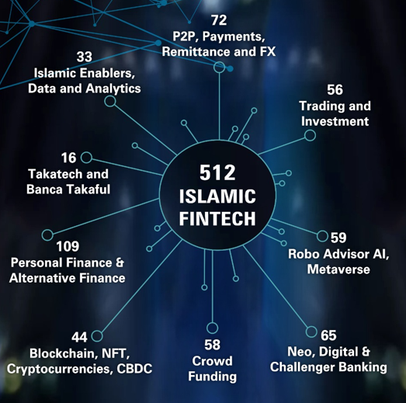
Industry Distribution
Global Islamic Fintech Firms
512 firms worldwide.
Top countries:
  Indonesia (65 firms)
  Malaysia (57 firms)
  UAE & Saudi Arabia (43 each)
  UK (43 firms).

Slide 7
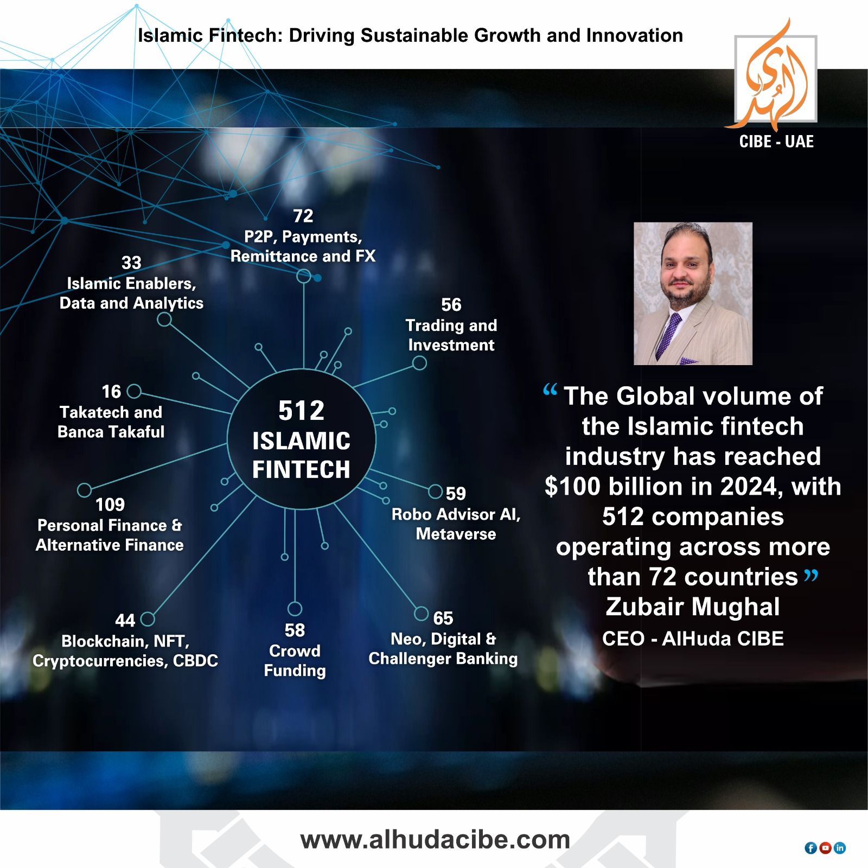

Slide 8


Slide 9
Blockchain
What is Blockchain?
A decentralized and secure digital ledger that records transactions transparently and immutably.
Eliminates the need for intermediaries, reducing costs and improving efficiency.
Implementation in Islamic Fintech:
Smart Contracts: Automating Shariah-compliant contracts for transactions like Zakat, Wakala, and Mudarabah.
Tokenization of Assets: Creating digital tokens representing real-world assets like gold or property, adhering to Shariah principles.

Slide 10
Cryptocurrency & NFT
What are Cryptocurrencies and NFTs?
Cryptocurrency: Digital currencies like Bitcoin or Ethereum based on blockchain technology.
NFTs: Non-fungible tokens that represent ownership of unique assets like digital art or real estate.
Example: Islamic Coin, a Shariah-compliant cryptocurrency
Implementation in Islamic Fintech:
Shariah-Compliant Cryptocurrencies: Developing cryptocurrencies that adhere to Islamic principles, such as avoiding interest-based transactions and speculation.
Tokenization of Islamic Assets: Creating NFTs representing Shariah-compliant assets like real estate or gold.

Slide 11
CBDC & Regtech
CBDC (Central Bank Digital Currency): A digital currency issued by a central bank.
Regtech (Regulatory Technology): The use of technology to improve regulatory compliance.
Example: Islamic CBDC Wallet, A digital wallet for storing and spending Shariah-compliant CBDCs.
Implementation in Islamic Fintech:
Shariah-Compliant CBDCs: Designing CBDCs that adhere to Islamic principles, such as avoiding interest and ensuring transparency.
Regtech for Islamic Finance: Using technology to streamline regulatory compliance for Islamic financial institutions.

Slide 12
Payments & Remittances
What are Payments and Remittances?
Payments: The transfer of funds between individuals or businesses.
Remittances: The transfer of money from one country to another.
Example: Islamic Remittance App, A mobile app for sending and receiving Shariah-compliant remittances.
PayHalal: A Shariah-compliant payment gateway.
Implementation in Islamic Fintech:
Shariah-Compliant Payment Systems: Developing payment systems that adhere to Islamic principles, such as avoiding interest and speculation.
Islamic Remittance Services: Providing fast, secure, and Shariah-compliant remittance services.

Slide 13
Metaverse, AR & VR
What are Metaverse, AR & VR?
Metaverse: A virtual universe where users can interact with each other and digital objects.
AR (Augmented Reality): Technology that overlays digital information onto the real world.
VR (Virtual Reality): Technology that creates immersive virtual environments.
Islamic Metaverse Bank: A virtual bank branch where customers can interact with Shariah-compliant financial services in a virtual environment.
Implementation in Islamic Fintech:
Islamic Metaverse: Creating virtual spaces for Islamic financial activities, such as virtual mosques, Islamic educational institutions, and halal marketplaces.
AR for Islamic Finance: Using AR to provide interactive Shariah-compliant financial services, such as virtual consultations with Islamic financial advisors.
VR for Islamic Education: Developing immersive VR experiences for Islamic education, such as virtual pilgrimages to Makkah and Madinah.

Slide 14
Robo-Advisor & AI
Robo-Advisor: An AI-powered investment platform that provides automated financial advice.
AI (Artificial Intelligence): The development of computer systems that can perform tasks that typically require human intelligence.
Example: Wahed Invest, which uses AI for halal investment portfolios.
Implementation in Islamic Fintech:
Shariah-Compliant Robo-Advisors: Developing AI-powered investment tools that offer Shariah-compliant investment advice.
AI for Fraud Detection: Using AI to detect and prevent fraud in Islamic financial transactions.
AI for Risk Management: Using AI to assess and manage risks in Islamic financial products.

Slide 15
Neo & Digital Banking
What are Neo & Digital Banking?
Neo-Banking: A new type of bank that operates solely online.
Digital Banking: The provision of banking services through digital channels.
Example: Islamic Mobile Banking App: A mobile app for accessing Shariah-compliant banking services, such as account balances, transfers, and investments. i.e. Al Maryah Community Bank
Implementation in Islamic Fintech:
Shariah-Compliant Neo-Banks: Developing online banks that offer Shariah-compliant financial products and services.
Digital Islamic Banking: Providing Islamic banking services through digital channels, such as mobile banking and online banking.

Slide 16

Top Sub-Sectors
Major Areas of Innovation
Alternative Finance: 64 firms (e.g., crowdfunding).
Payments: 63 firms (digital solutions).
Fundraising: 62 firms.
Wealth Management: 57 firms (Shariah-compliant investments).
Deposit & Lending: 49 firms (Islamic banking).

Slide 17

Challenges
Barriers to Growth
Regulatory diversity.
Limited consumer awareness.
Access to capital for startups.
Talent acquisition in finance, technology, and Shariah.

Slide 18

Opportunities
Unlocking Growth Potential
Expansion in South and Southeast Asia.
Emerging segments:
  Digital assets.
  Shariah-compliant insurance.
  Social finance.
Innovations in DeFi and halal wealth management.

Slide 19

Future Outlook
A Promising Future
Cross-sector collaborations.
Supportive policies and frameworks.
Greater financial inclusion for Muslim and non-Muslim populations.

Slide 20

Conclusion
The Role of Islamic Fintech
Bridging ethical finance and technological innovation.
Contributing to global financial inclusion.
Providing sustainable and Shariah-compliant solutions.

Slide 21
Thank You!
Muhammad Zubair
CEO : AlHuda CIBE
info@alhudacibe.com
Website: https://www.alhudacibe.com/

